Slide 1
STROKE PREDICTION
Prepared and presented by:
Julian Cadavid
Vy Tran
Tuan Anh Nguyen
Kewal Tadas

Slide 2
Domain problem
According to the World Health Organization (WHO) stroke is the 2nd leading cause of death globally, responsible for approximately 11% of total deaths. This project is an attempt to build a machine learning model to predict the chances of stroke based on general factors such as underlying health issues and lifestyles.

Slide 3
Data collection & Description
About The Data -
Type of data - It is a medical records of people.
The size of the dataset - The Dataset has about 5110 rows and 11 columns.
The source - The dataset is taken from kaggle and but the source is confidential.
Quality of the data - Data was pretty cleaned as we only had about 201 null values in BMI column.
How the data were processed - we have removed whatever null values we had in the data.
Notes:
Hi

Slide 4
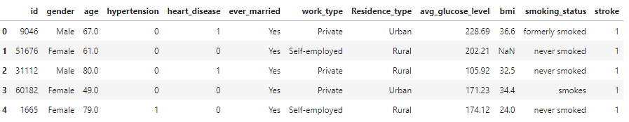
Here, we can see there are 10 independent variables which we will use as predictors & 1 dependent variable called Stroke.
As we already have target variable that is stroke as outcome in the dataset so it’s a classification type model.

Slide 5
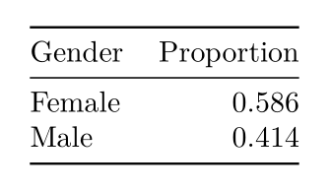
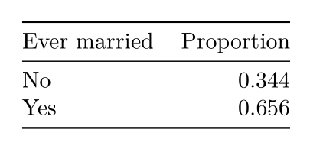
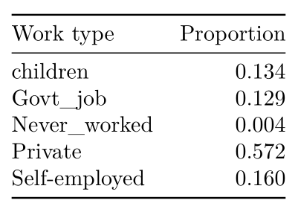
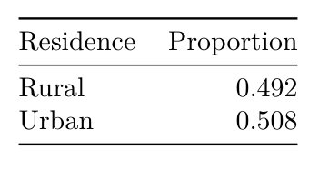
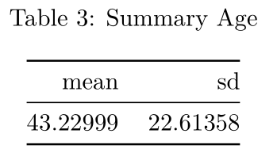
Exploratory Data Analysis
This data set has 5109 rows and 12 variables

Slide 6
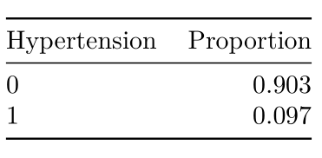
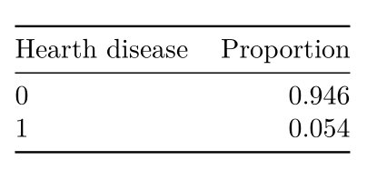
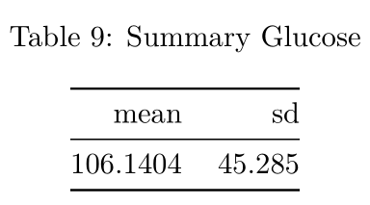
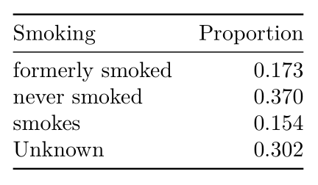
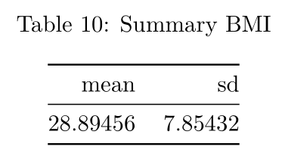
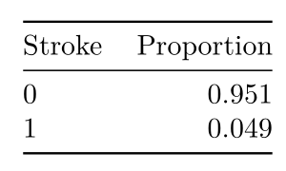
Exploratory Data Analysis

Slide 7
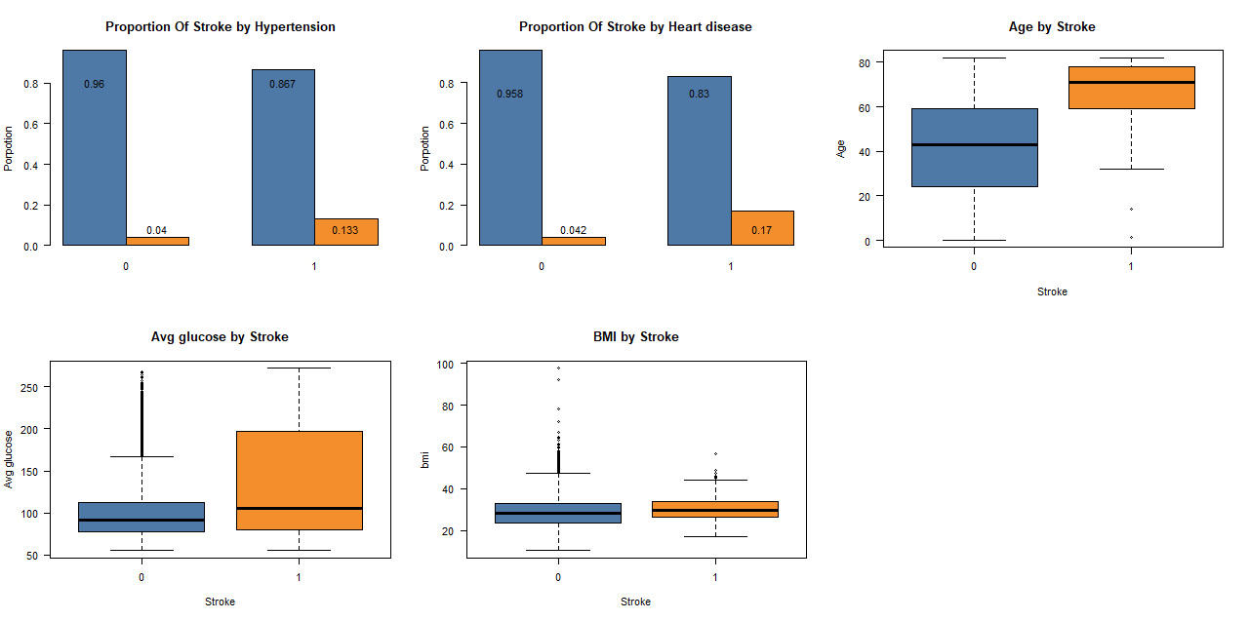
Exploratory Data Analysis

Slide 8
Modeling
Type of machine learning : supervised learning in classification.
Type of model: Logistic Regression, XGBoost, and tree-based Models (Decision Tree and Random Forest).

Slide 9
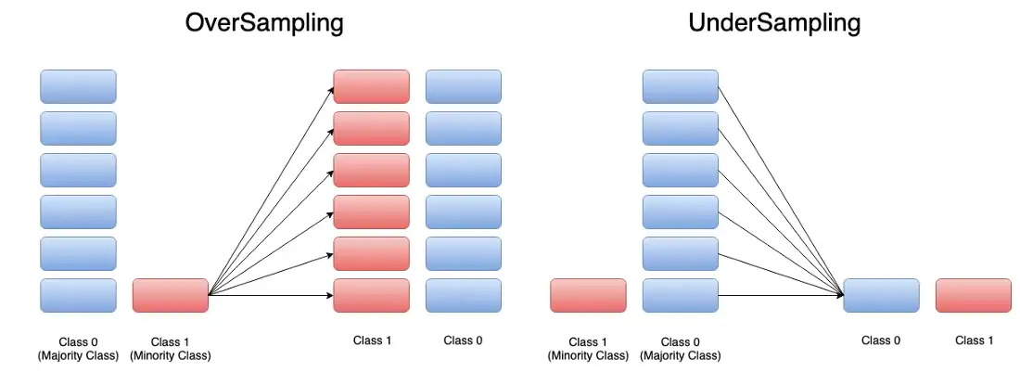

Modeling Methods
How to resolve the imbalanced data issue?
BALANCE WEIGHT
RESAMPLING

Slide 10
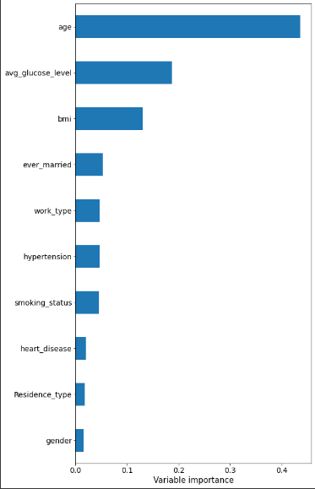
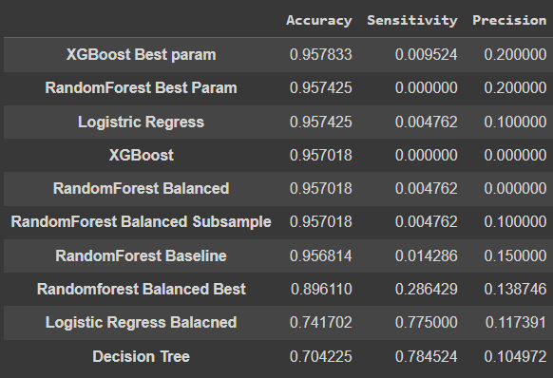
Evaluation and interpretation of model
Model selection
Random Forest variable importance
Age: 43.5%
Glucose: 18.74%
BMI: 13.05%
10-fold cross validation or mean Accuracy, Sensitivity, and Precision

Slide 11
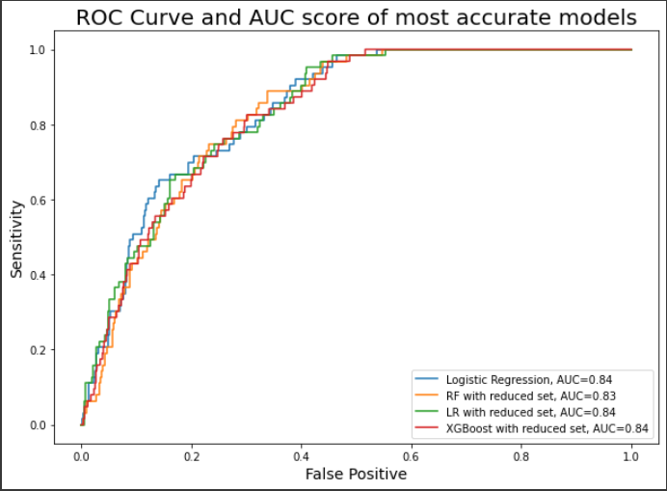
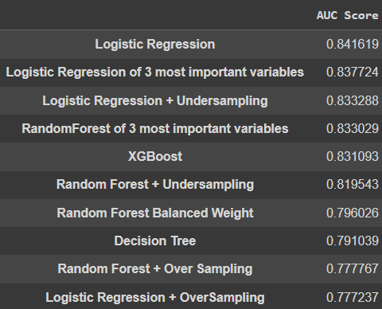
Evaluation (cont.)
ROC curve and AUC score of most accurate models
AUC Score
AUC Score of models with sampling methods and reduced predictors.

Slide 12
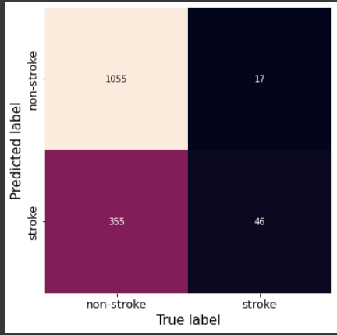
Evaluation (cont.)
Logistic Regression confusion matrix
Sensitivity: 0.73
Specificity: 0.75
False Negative Rate: 0.27
False Positive Rate: 0.25
Overall Accuracy: 0.75

Slide 13
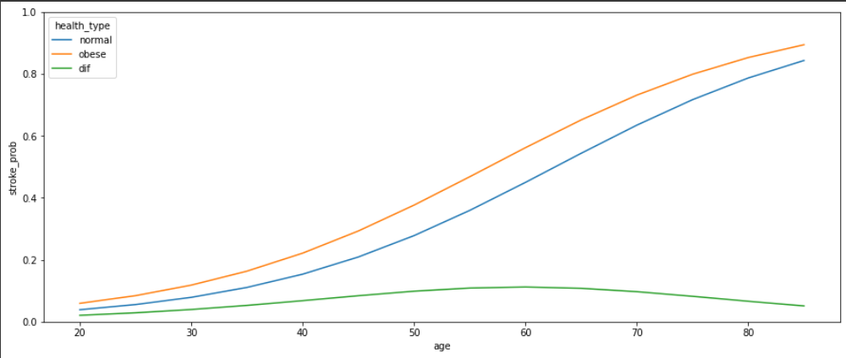
Comparing health conditions
Healthy and obese person chance of getting stroke by age
At age 60, an obese person have 56% probability to get stroke, while a healthy person have 45%.
Normal: BMI 20 and AGL 70, Obese: BMI 30 and AGL 120

Slide 14
Conclusion
Stroke probability directly related to older people, with high glucose level and high BMI. These 3 predictors have 75% predictive power combined. Also, people with underlying conditions like hypertension and heart disease are more likely to also get stroke.
Our Logistic Regression Model have 84% probability to identify people who have stroke (from AUC score).

Slide 15
References
Obermeyer, Z., Powers, B., Vogeli, C. & Mullainathan, S. Science 336, 447–453 (2019).
Bais, Gourav. “How to Handle Imbalance Datasets for Classification Use-Cases.” Medium, Heartbeat, 24 Oct. 2022, https://heartbeat.comet.ml/how-to-handle-imbalance-datasets-for-classification-use-cases-de97806711d.
Mandrekar , Jayawant, et al. “Receiver Operating Characteristic Curve in Diagnostic Test Assessment.” Journal of Thoracic Oncology, Elsevier, 20 Nov. 2015, https://www.sciencedirect.com/science/article/pii/S1556086415306043#:~:text=In%20general%2C%20an%20AUC%20of,than%200.9%20is%20considered%20outstanding.

Slide 16
Thank you for listening!

